Slide 1
Disclosures
I have received honoraria from CSL Vifor, Napp Pharmaceuticals and research funding from the Medical Research Council and Barts Charity

Slide 2


When to Consider Testing Collagen Genes in General Nephrology Practice
Dr Thomas Oates PhD FRCP
Consultant Physician
Departments of Nephrology & General Medicine
Royal London Hospital
Barts Health
London, UK
@jfnephlolz

Slide 3




When to Consider Testing Collagen Genes in General Nephrology Practice
COL4A3
COL4A4
COL4A5
Variants & Disease
Phenotypes
Treatment
Haematuria
Proteinuria/FSGS
Young Onset Kidney Failure
Type IV Collagen cartoon by Caitlyn Vlasschaert
Notes:
So later in this session we are going to hear abou

Slide 4

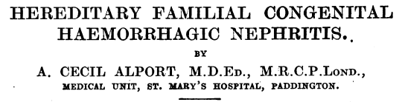
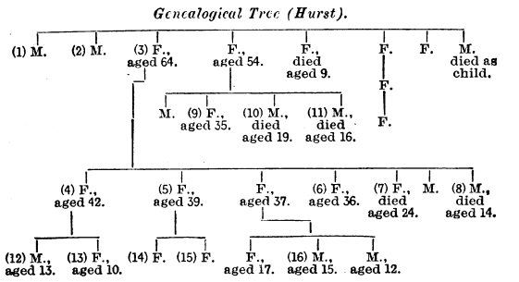
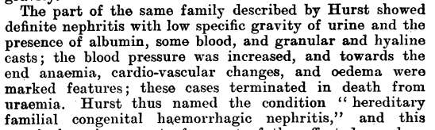
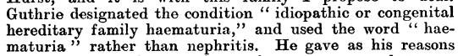
Alport, BMJ, 1927

Slide 5
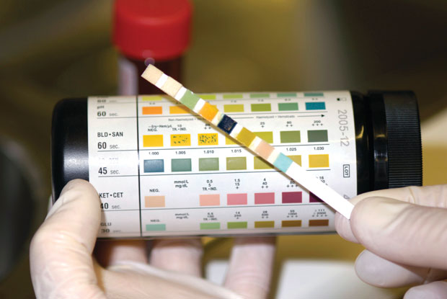
Haematuria
Glomerular
Dysmorphic RBCs +/- casts
Non-Glomerular
Classical
Proteinuria
CKD
Isolated

Slide 6
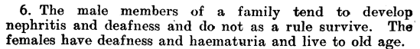
Alport, BMJ, 1927

Slide 7

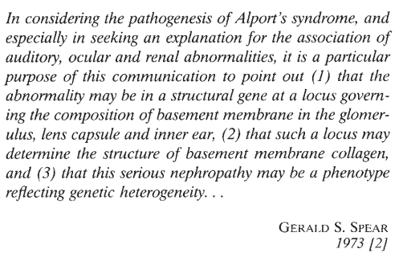
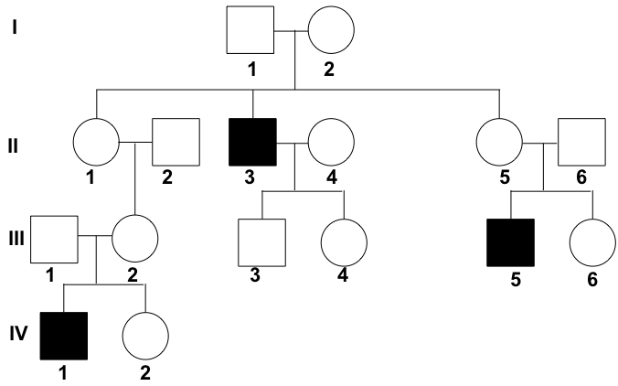
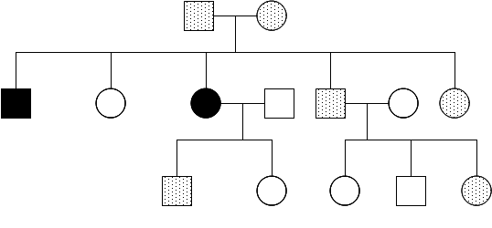
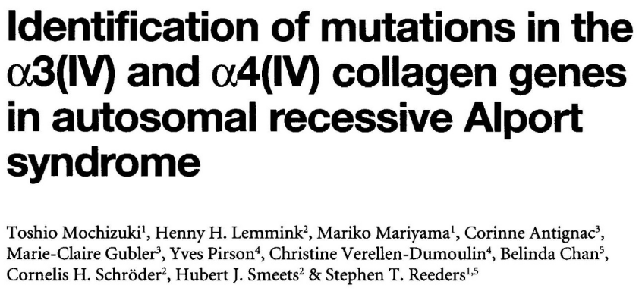
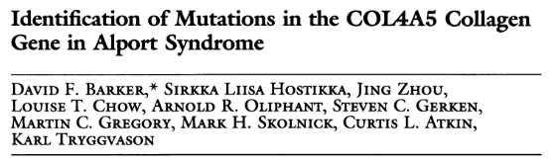
Collagen & the Glomerular Basement Membrane
Spear quoted in Kashtan & Michael, Kidney Int, 1996; Type IV Collagen cartoon by Caitlyn Vlasschaert
Barker et al, Science, 1990; Mochizuki et al, Nat Genet, 1994

Slide 8
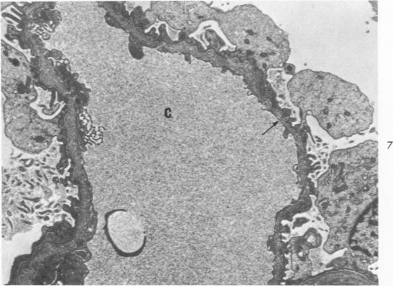
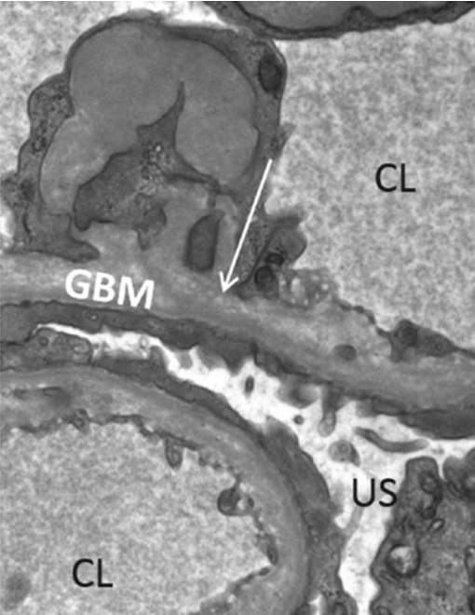
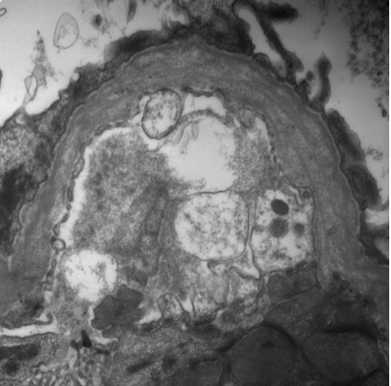
Characteristic Electron Microscopy
Spear & Slusser, Am J Path, 1972; Chan & Gale, Clin Med, 2015; Fogo et al, AJKD, 2016

Slide 9
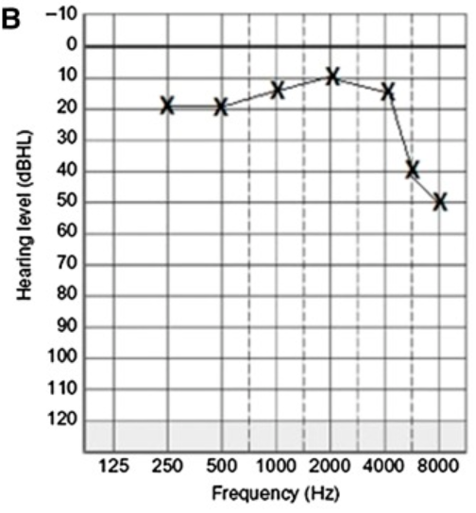
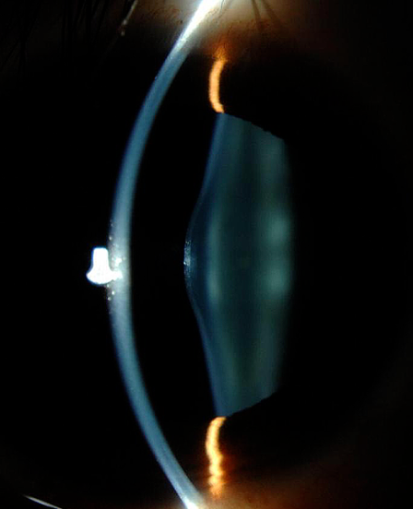
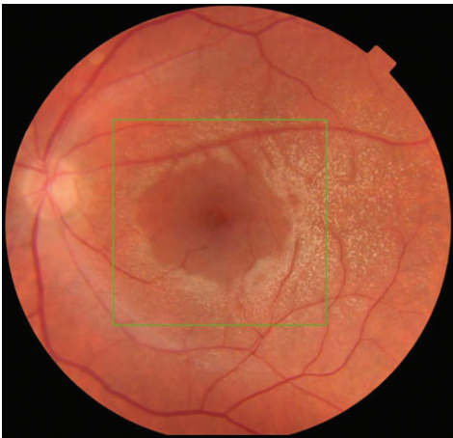
Non-Renal Manifestations of Alport Syndrome
Savige et al, CJASN, 2016; Halawani et al, Cureus, 2021; Taylor & Flinter, Arch Dis Child, 2014

Slide 10
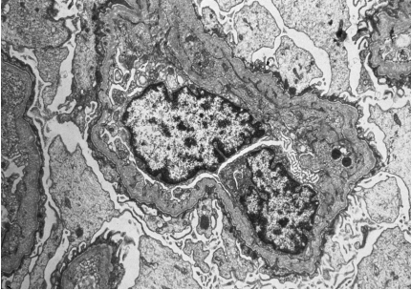
When to Consider Testing Collagen Genes in General Nephrology Practice: Haematuria
Persistent Glomerular Haematuria
Family History
Alport
Haematuria
Unexplained Kidney Failure
Non-Renal
Characteristic EM

Slide 11
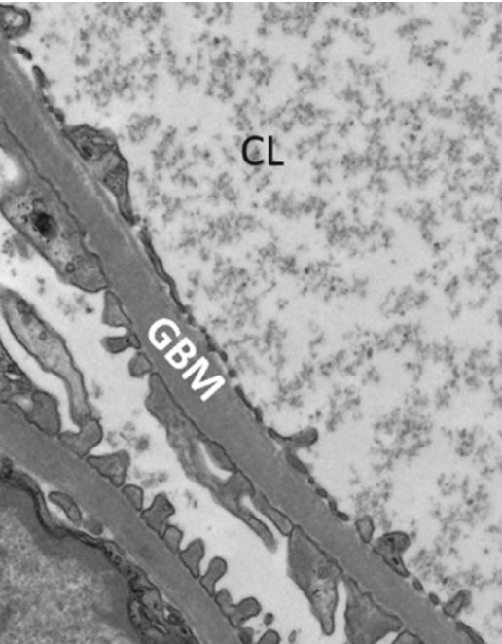
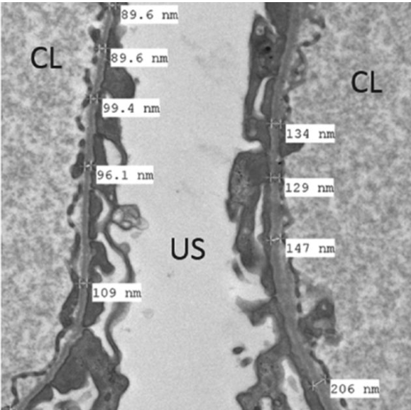
Thin Basement Membranes
Chan & Gale, Clin Med, 2015

Slide 12
When to Consider Testing Collagen Genes in General Nephrology Practice: Haematuria
Persistent Glomerular Haematuria
Family History
Alport
Haematuria
Unexplained Kidney Failure
Non-Renal
Characteristic EM
Alport
TBMN

Slide 13
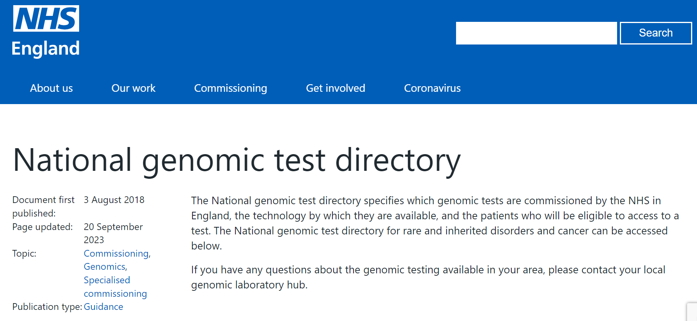
Testing Collagen Genes in Haematuria: The UK Experience
Search: Genomic Test Directory

Slide 14
Testing Collagen Genes in Haematuria: The UK Experience
Phenotype
Genes
Haematuria plus ONE of:
1st degree relative with haematuria or unexplained CKD
EM evidence of thickening and splitting of glomerular basement membrane OR thin basement membrane
Hearing or eye features of Alport
COL4A3, COL4A4, COL4A5
COL4A1 Exophytic cysts & angiopathy
MYH9 Macrothrombocytopenia

Slide 15
Testing Collagen Genes in Haematuria: The UK Experience
Variable | Count (%)
Age | 23 (IQR 31)
Male Female | 100 (52) 91 (48)
Family History AS/TBMN CKD Haematuria Unknown | 8 (4) 37 (19) 61 (32) 84 (44)
Biopsy Findings AS TBMN Other Unknown | 9 (5) 38 (20) 5 (3) 139 (73)
Extra Renal Alport Yes No | 18 (9) 173 (91)
Age at submission of test sample
Count
Age

Slide 16
Testing Collagen Genes in Haematuria
Variants detected in 67 out of 183 patients (37%)
66 in COL4 genes
58 (32%) pathogenic or likely pathogenic
Variants Detected | Heterozygous COL4A3/A4 | XLAS | COL4A3/A4 : COL4A5
25 | 22 | 3 | 22:3 = 7.3

Slide 17
When to Consider Testing Collagen Genes in General Nephrology Practice
COL4A3
COL4A4
COL4A5
Variants & Disease
Phenotypes
Treatment
Haematuria
Proteinuria/FSGS
Young Onset Kidney Failure
Type IV Collagen cartoon by Caitlyn Vlasschaert
Notes:
So later in this session we are going to hear abou

Slide 18
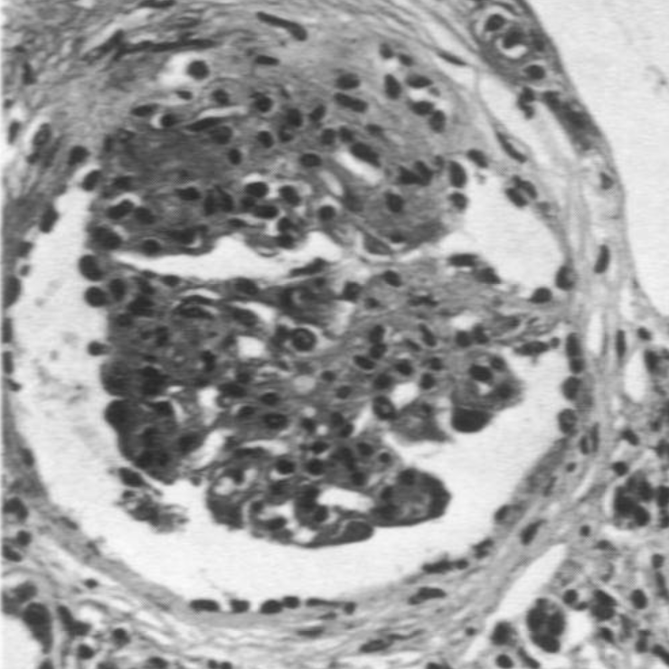
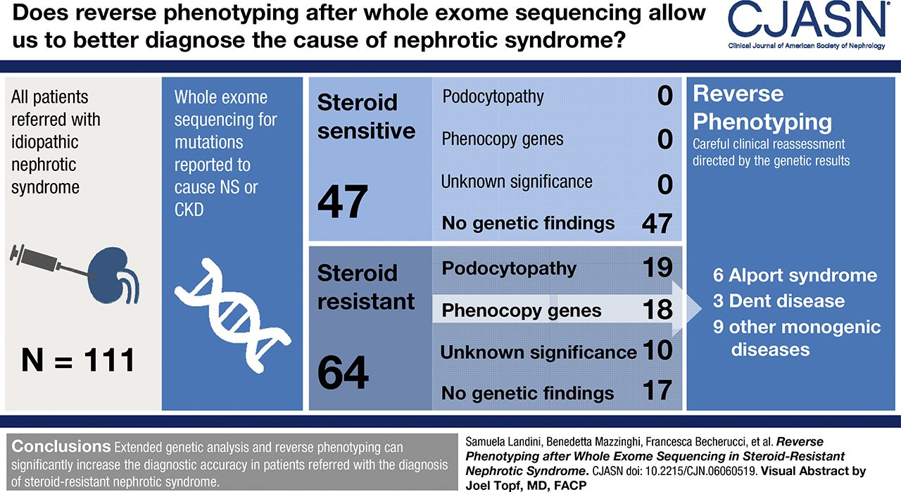
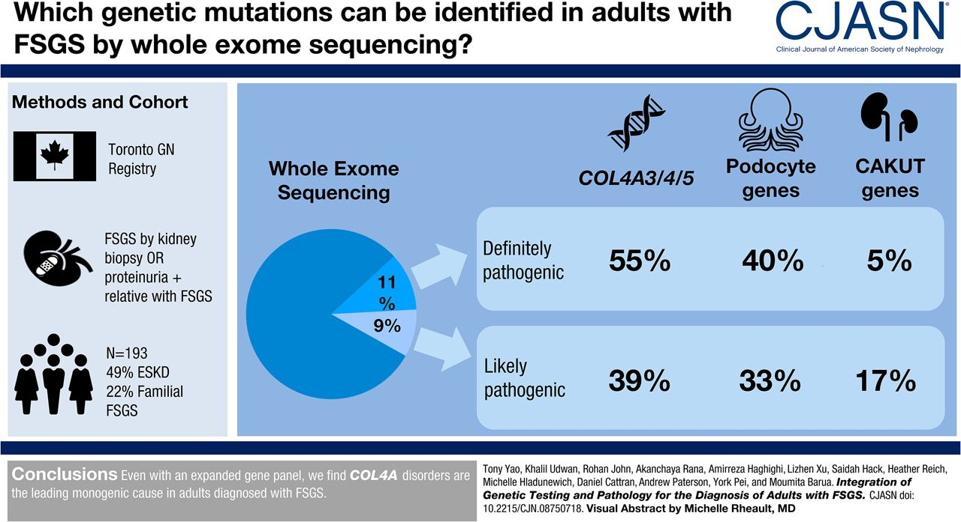
Collagen Genes, Proteinuria & FSGS
Spear & Slusser, Am J Path, 1972; Landini et al, CJASN, 2020; Yao et al, CJASN, 2019

Slide 19
Testing Collagen Genes in Proteinuria: The UK Experience
Phenotype
Genes
Steroid resistant nephrotic syndrome presenting at any age
Proteinuria with FSGS or diffuse mesangial sclerosis with no obvious cause IF a transplant or immunosuppression is planned
COL4A3, COL4A4, COL4A5
ACTN4, AMN, APOE, ARHGDIA, CD151, CLCN5, COQ2, COQ6, COQ8B, CRB2, CUBN, DAAM2, DGKE, DLC1, FAT1, FN1, GLA, GON7, INF2, ITGA3, ITSN1, LAGE3, LAMB2, LCAT, LMX1B, MAGI2, MYH9, MYO1E, NPHS1, NPHS2, NUP107, NUP133, NUP85, NUP93, OCRL, OSGEP, PAX2, PDSS2, PLCE1, PODXL, SCARB2, SGPL1, SMARCAL1, TBC1D8B, TNS2, TP53RK, TPRKB, TRIM8, TRPC6, WDR73, WT1, YRRDC

Slide 20
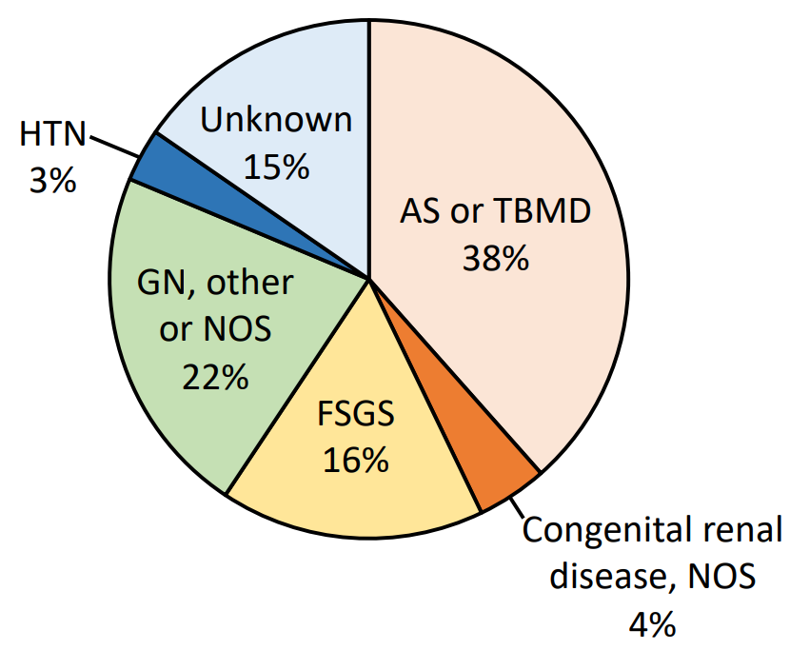
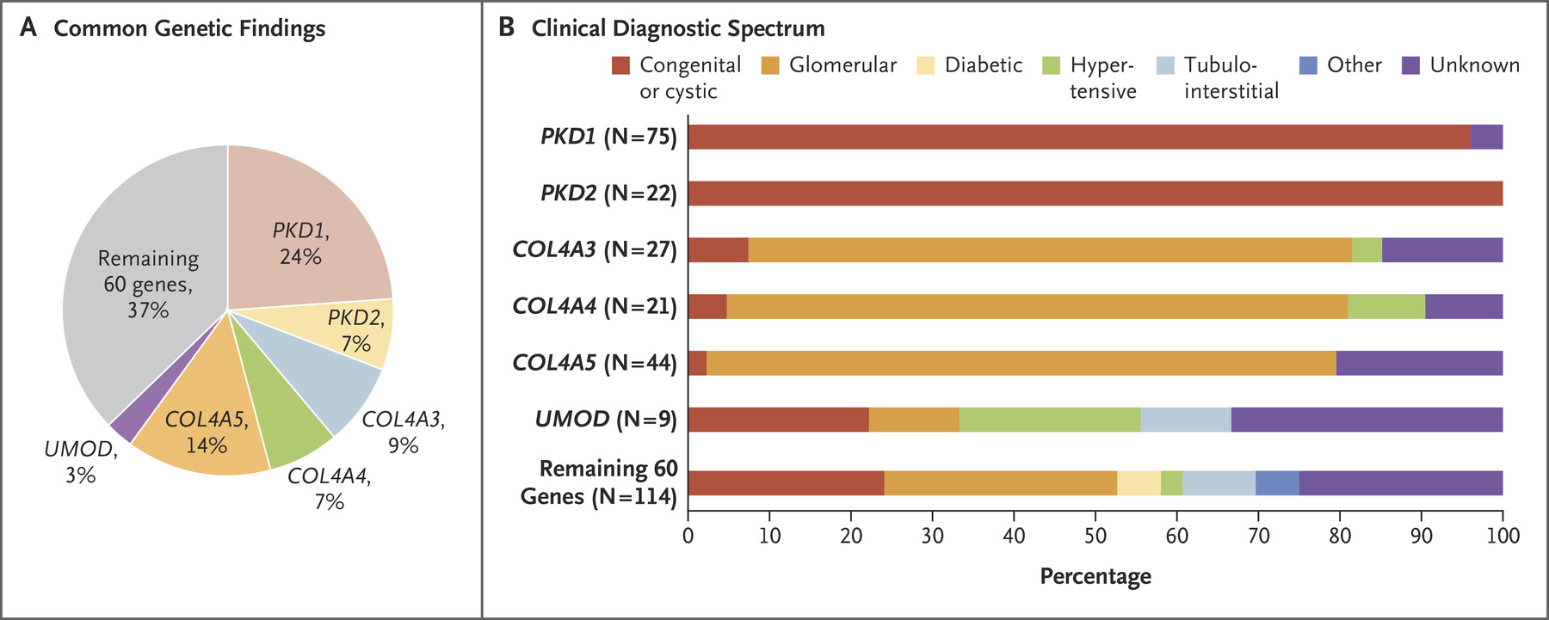
Testing Collagen Genes in Chronic Kidney Disease
Groopman et al, NEJM, 2019

Slide 21
Testing Collagen Genes in CKD: The UK Experience
Phenotype
Genes
Kidney failure developing under age 36
With no identifiable cause detectable by:
Renal biopsy
Biochemistry
Imaging
Clinical assessment
Whole Exome Sequencing to evaluate 183 genetic entities
Use of this test in young adults over 36 may be appropriate if strong clinical suspicion of a monogenic disorder

Slide 22
When to Consider Testing Collagen Genes in General Nephrology Practice
COL4A3
COL4A4
COL4A5
Variants & Disease
Phenotypes
Treatment
Haematuria
Proteinuria/FSGS
Young Onset Kidney Failure
Type IV Collagen cartoon by Caitlyn Vlasschaert
Notes:
So later in this session we are going to hear abou

Slide 23
Summary
Haematuria
Proteinuria
Kidney failure under 36
Plus 1 of
1st deg relative haematuria or unexplained CKD
EM findings
Extra renal
SRNS
Or
FSGS if Transplant or IS planned
If cause unknown

Slide 24
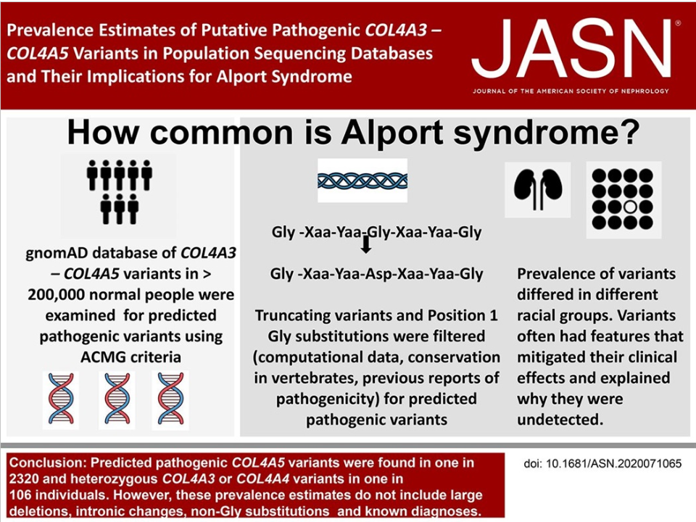
A Closing Caveat
Gibson et al, JASN, 2021

Slide 25
Acknowledgment
Ruth Nicholson
North Thames Genetic Laboratory Hub
Thomas.oates1@nhs.net
toates19@gmail.com
@jfnephlolz

